Slide 1







Company Profile
TRAINING
PORTFOLIO
100++
Great Organisations and Companies Using Our Services

Slide 2






Our Services
What is Sanggabiz?
  Billing Management
  Banking/Payment
  Sales Invoice
  Accounting
  Tax Support
  Operation Excellence
  SOP
  Operation Admin
  SosMed Content Management
  SosMed Ads Management
  Marketing Performance
  SEO/SEM
  Personal Branding
Sanggabiz adalah solusi bisnis virtual yang menyediakan layanan departemen-as-a-service, termasuk Keuangan, SDM, Layanan Pelanggan, Pemasaran, Manajemen Proyek, Administrasi, dan Operasional dengan memberdayakan wanita/ibu dan penyandang disabilitas. Kami membantu Anda menghemat hingga 80% biaya tenaga kerja.
  Project Management
  Payroll
  HR Admin
  Personal Income Tax
  Recruitmen
  Telemarketing
  Customer service
  Knowledge Management
  Training
#TerimaBeres

Slide 3




What Our Experts Have Done
Consulting
Training
Ops & System Mgt
Experts in Marketing, Business Roadmap, Operations, Sales Strategy, Finance/Tax
Experts in Marketing, Customer Retention, Digital Product, Operations, Career Dev
Experts in Finance/Acct/Tax, HR, Operations, Customer Support, User Acquisition, Telemarketing, System Monitoring & Implementation
Cambridge, Jakarta, Yogyakarta, Aceh
Semarang, Jakarta, Yogyakarta
Cambridge, Jakarta, Yogyakarta, Aceh
Manufacturing, Technology, Retail, Government
Academia, Government, Manufacturing, Retail, Technology
Manufacturing, Fashion, Technology, Retail, F&B, Government, Family Office
Amazon Alexa, Yakes Pertamina, Pemkot Yogyakarta, PT PIM
Rey.ID, KitaBisa, Indosat Ooredoo Hutchison, Amar Bank, Glints, UMY, Inspirasi Foundation
Supra, KitaBisa, Rey, One Click Life, Alterra, Riliv, AJS, Wiratama Institute, Freesa, Lingo Talk, Inisago, Kuncie
  Customer Retention
  Operations Healthiness
  Workforce Analysis
  Business Diagnostics
  Social Media Mgt
  Customer Retention
  Digital Finance System
  Organizational Innovation
  Finance/Accounting/Tax
  Customer Support
  HR Ops and Recruitment
  Invoicing/AR/Disbursement
  Customer Research
  Telemarketing B2C/B2B

Slide 4






Sanggabiz in Numbers
6.000+
11000+
400+
Mitra Engagement
(Private Sector & Government)
Total User
(B2C, B2B, B2G)
Channel Media Partner
100+
500+
400+
Total Team
(Expert & Trainer)
Total Community Partners
Total Project and Service

Slide 5
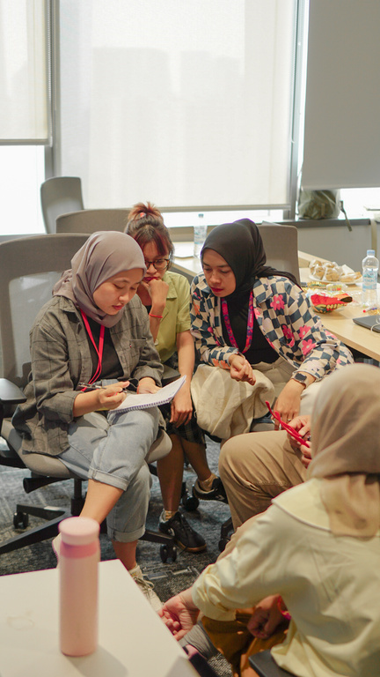
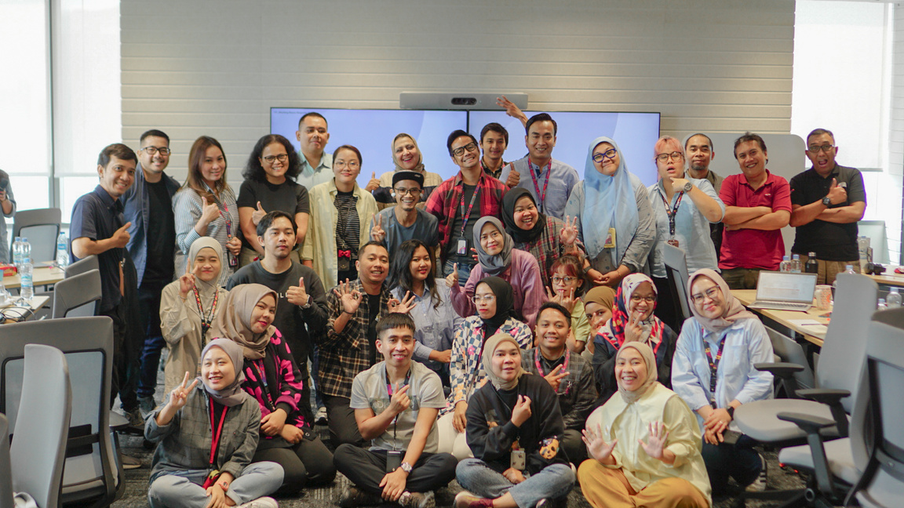
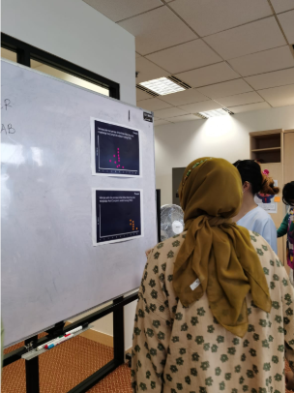
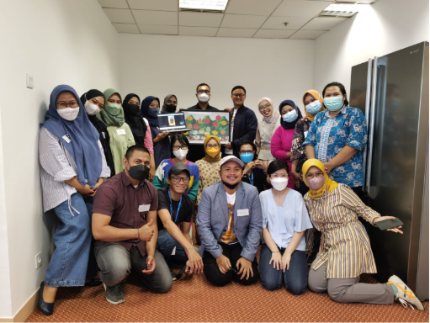
















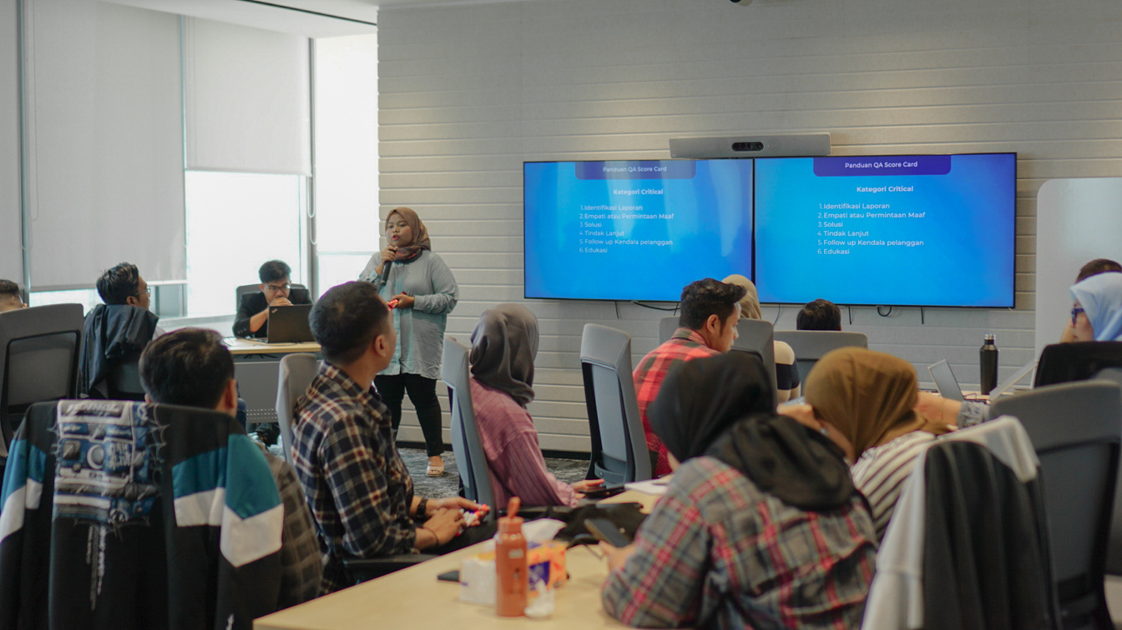
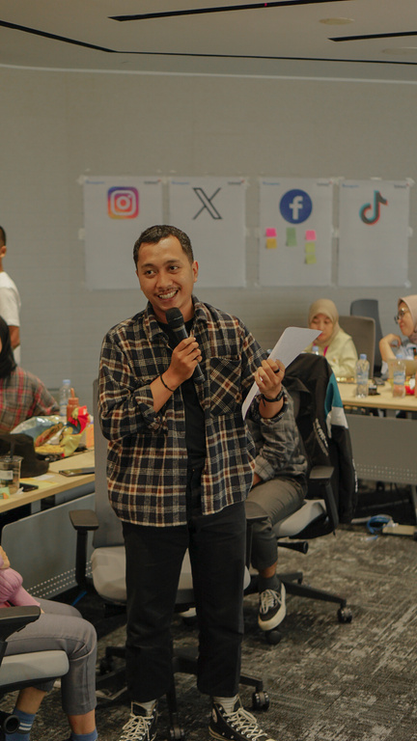



















TRUSTED BY LEADING COMPANIES
and many more training events and collaborations!

Slide 6
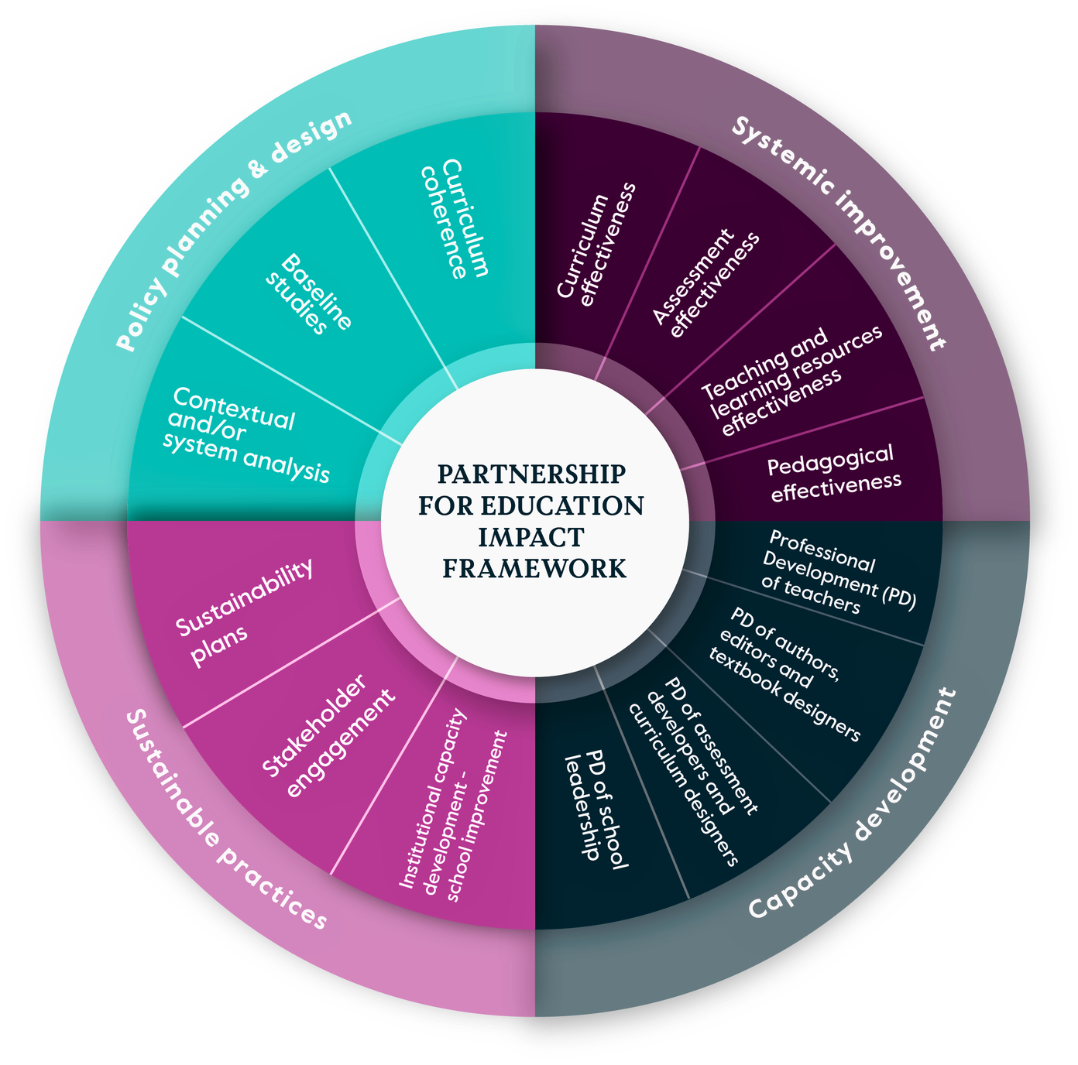

Framework
Using Cambridge Framework for Training Development
The training would be tailored with the needs of the students/audiences, while all using the ‘continuous learning’ approach:
  Define
  Design
  Deliver
  Discuss
the Knowledge Gap
the Tailored Curriculum
the Breakthrough Training
the Improvement Post-Training

Slide 7
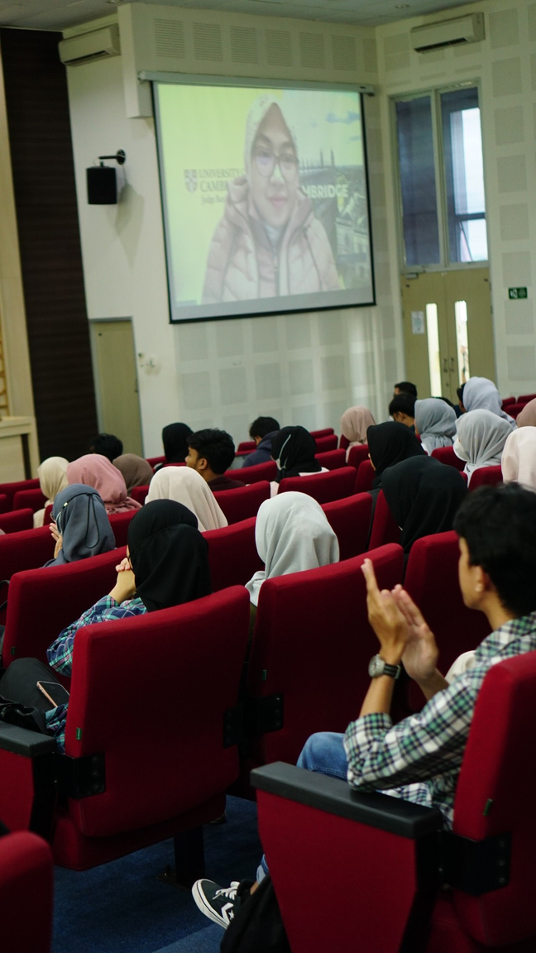
OUR TRAINING SPECIALITIES
PROFESSIONAL TRAINING
SOFT SKILL TRAINING
CUSTOMIZE TRAINING
  Leadership
  English Communication for Sales
  Creative Problem Solving and Decision Making
  Strategic Leadership
  Creative Thinking,etc
  How to Manage Hard Complaints
  Managing Effective CS Techniques for Gen Z
  Business Process for CS Operations
  How to optimize Digital Marketing
  Etc
Tailored training topics designed to meet your company's needs, powered by the proven
Cambridge Training Framework

Slide 8


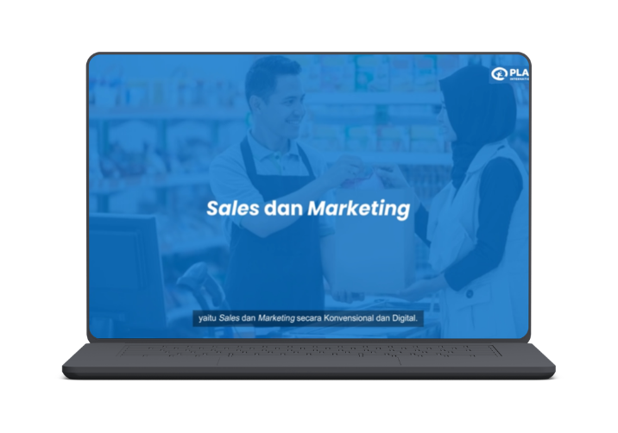
PORTOFOLIO
FUTUREMAKERS YOUTH EMPLOYMENT PROGRAMME & TECH PATH
SALES MODUL
MODUL DEVELOPMENT PORTFOLIO
AKSES FULL VIDEO PEMBELAJARAN
KLIK DI SINI
AKSES FULL MODUL
KLIK DI SINI
AKSES FULL MATERI PRESENTASI
KLIK DI SINI
Jumlah video pembelajaran yang telah diproduksi sebanyak 16 video pembelajaran

Slide 9
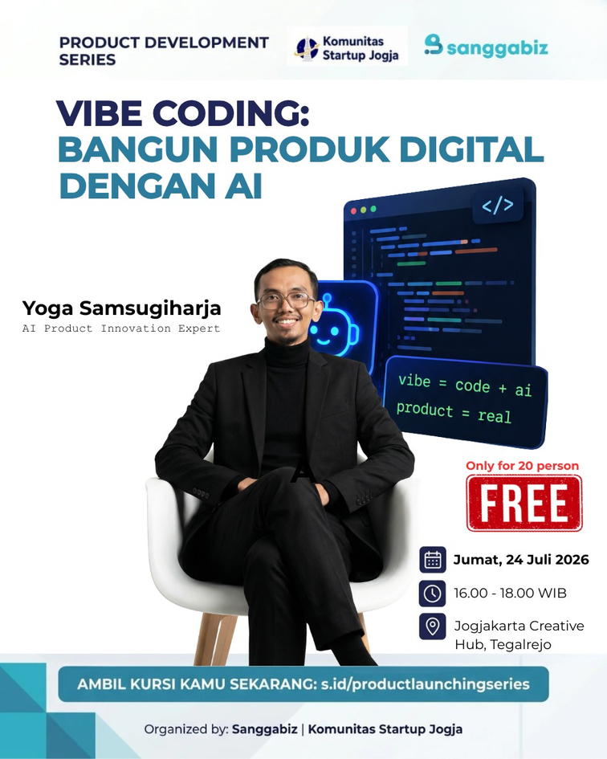

DIGITAL TRAINING PROJECT

Slide 10

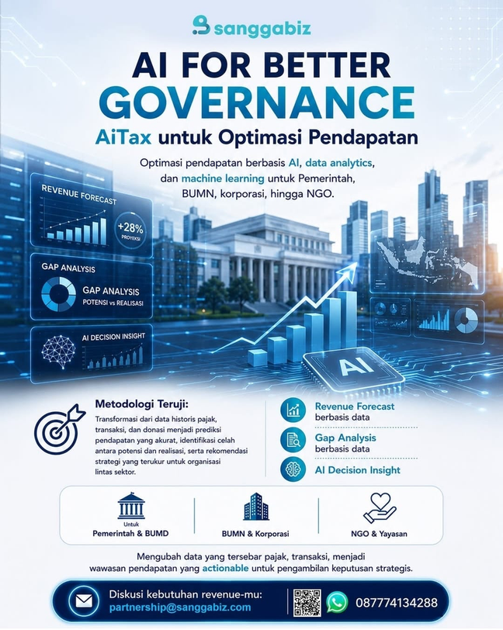
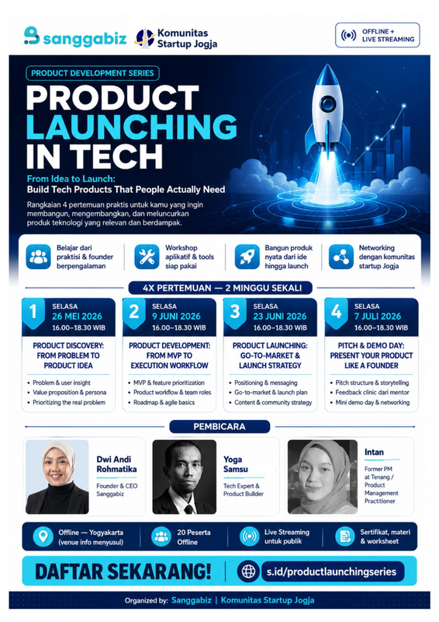
DIGITAL TRAINING PROJECT

Slide 11
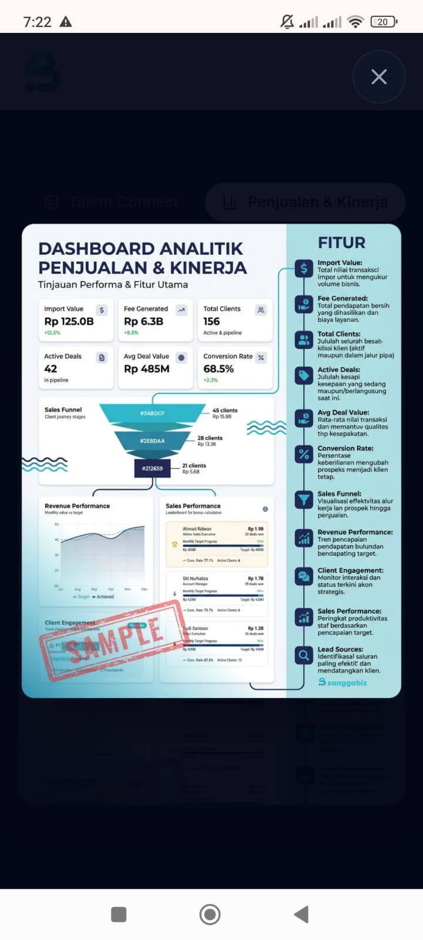
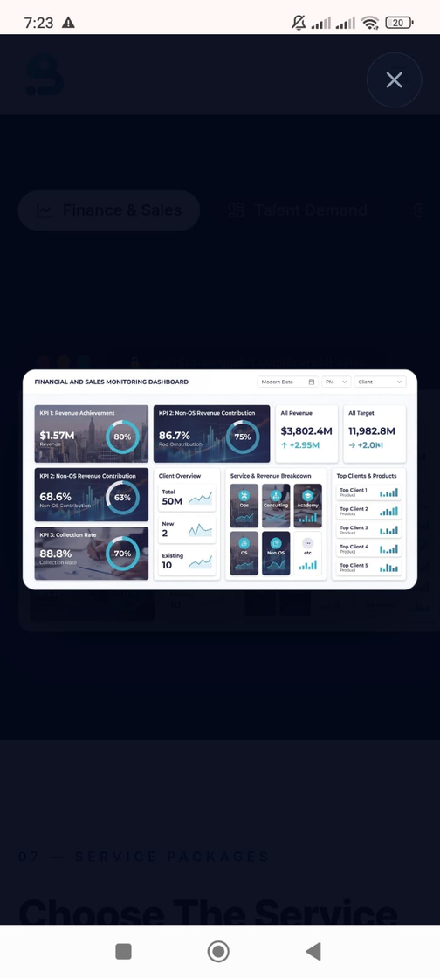
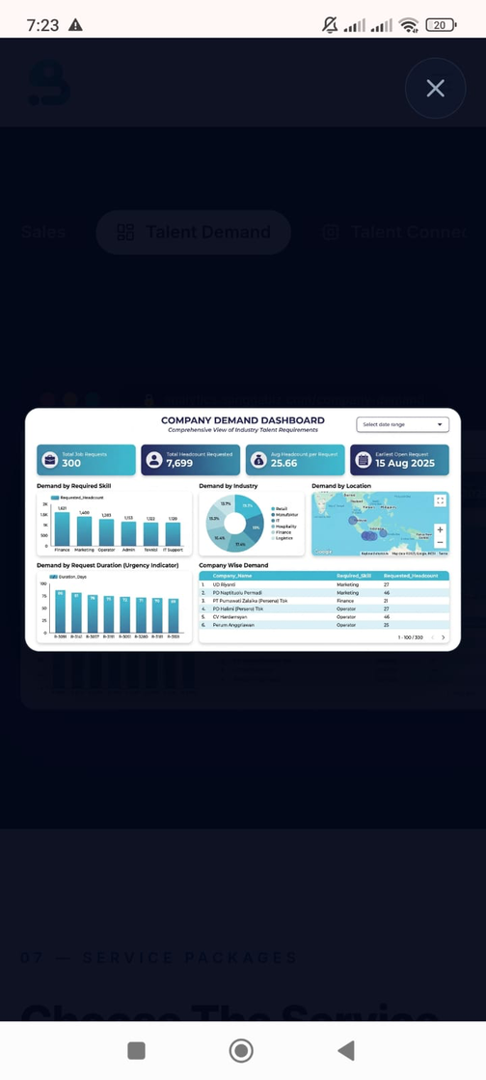
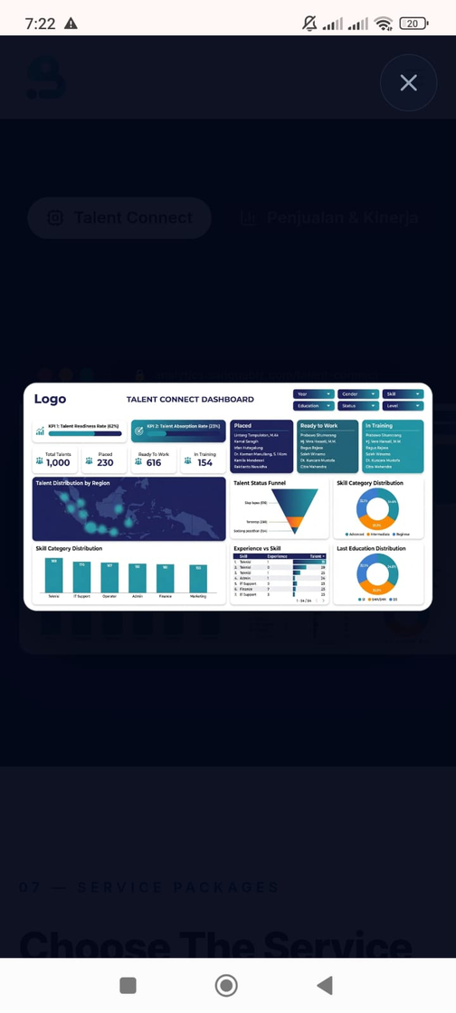
DIGITAL TRAINING OUTPUT

Slide 12
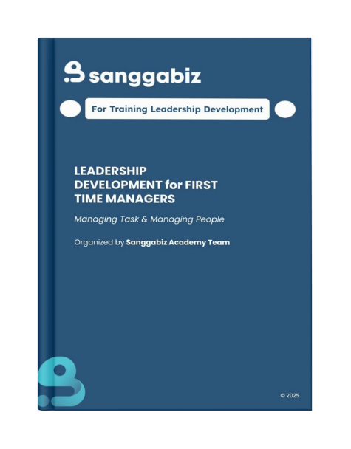

PORTOFOLIO
PROGRAM PELATIHAN LEADERSHIP FOR FIRST TIME MANAGER
PORTOFOLIO
PROGRAM PELATIHAN DAN PENYUSUNAN MODUL STEM
MODUL DEVELOPMENT PORTFOLIO
AKSES FULL MODUL
KLIK DI SINI
AKSES FULL MODUL
KLIK DI SINI

Slide 13


DEVELOPMENT CLASS
AMARTHA CENDEKIA
End-to-End Class Management
OUR ONGOING PROJECT

Slide 14
FUTUREMAKERS YOUTH EMPLOYMENT PROGRAMME
Retail Skills for Youth Empowerment & TechPath Bojonegoro
OUR ONGOING PROJECT
P - L - A - N
Prepare for Work
Learn Technical Skill
Apply in Real Projects
Navigate Career Journey
Soft skill bootcamp:
mindset, teamwork, komuniasi, dan lain - lain
Sales, social media, CRM via e-learning dan live zoom
Capstone project bersama UMKM dan retail partner
Job matching, CV clinic, career mentoring
FUTUREMAKERS YOUTH EMPLOYMENT PROGRAMME (FYEP)

Slide 15
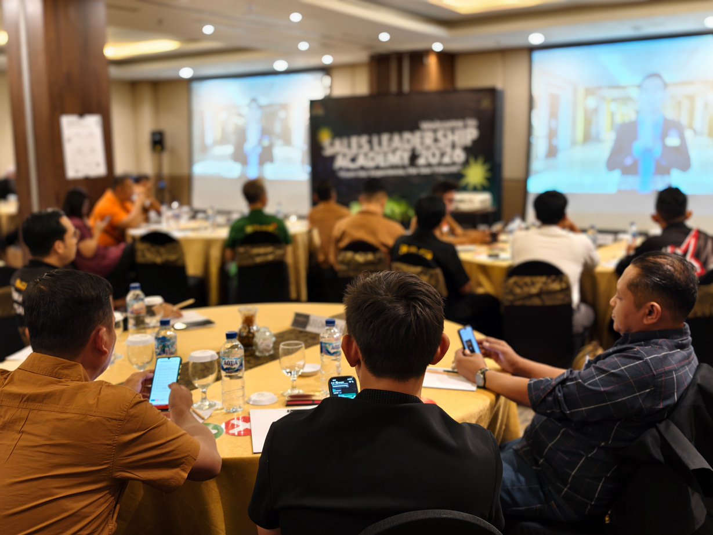
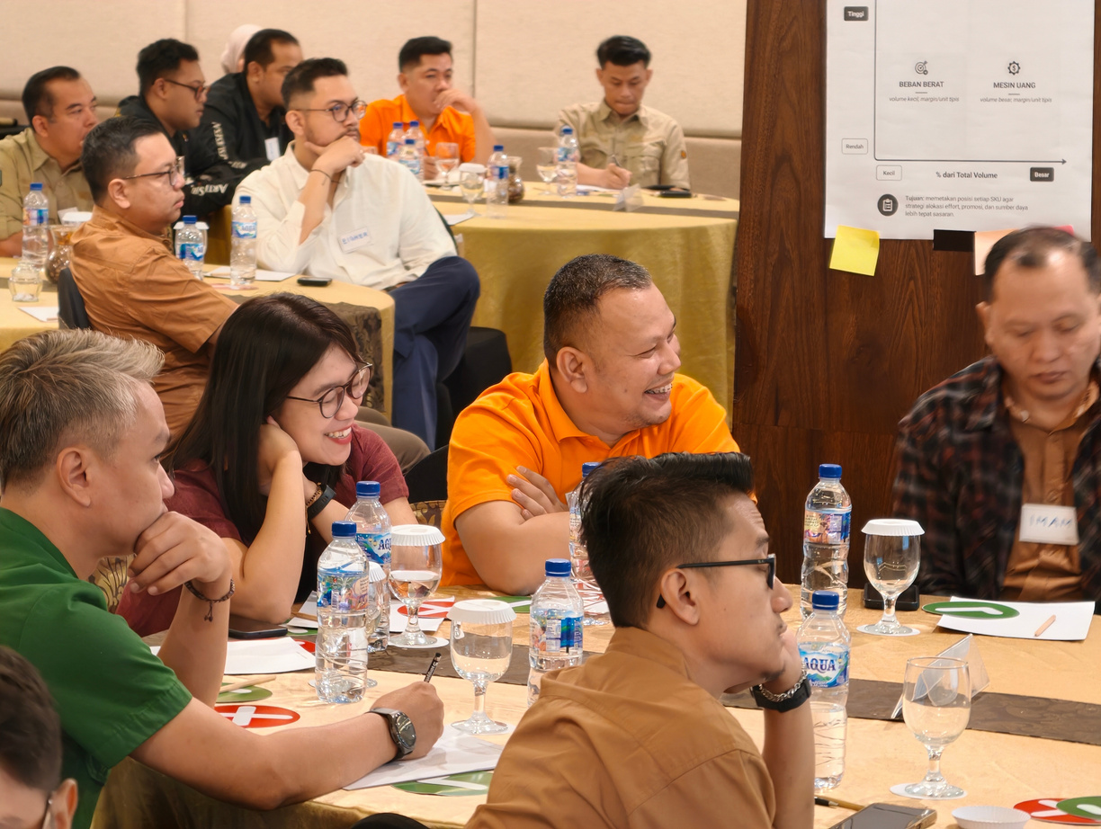
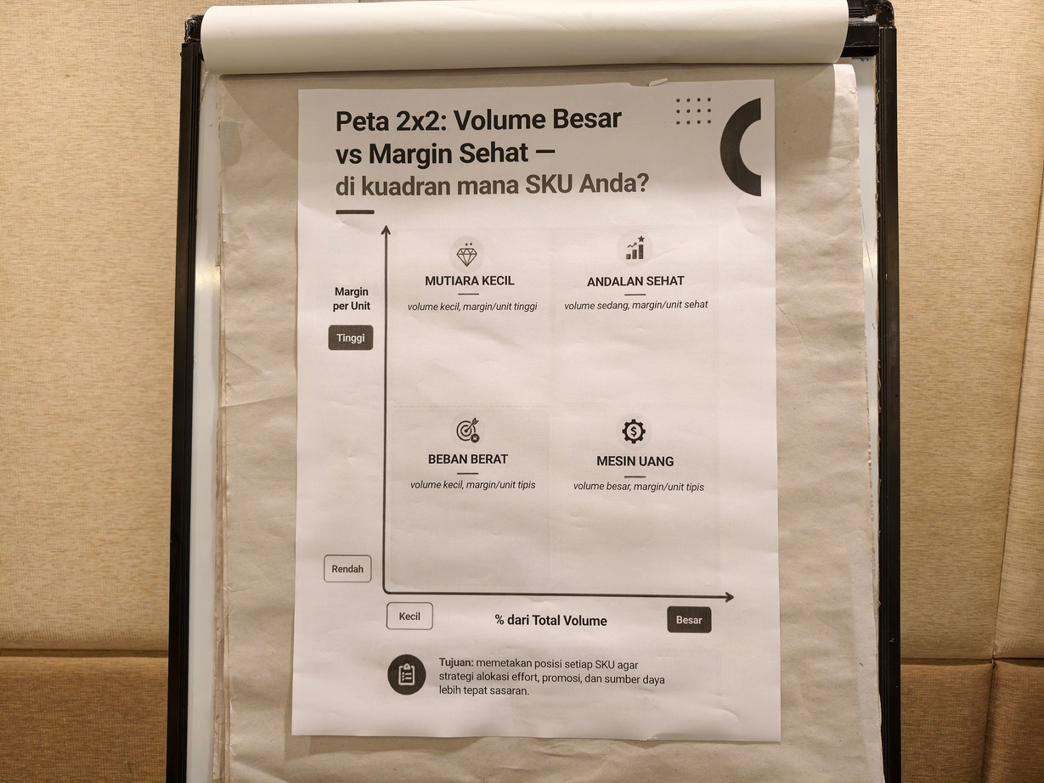

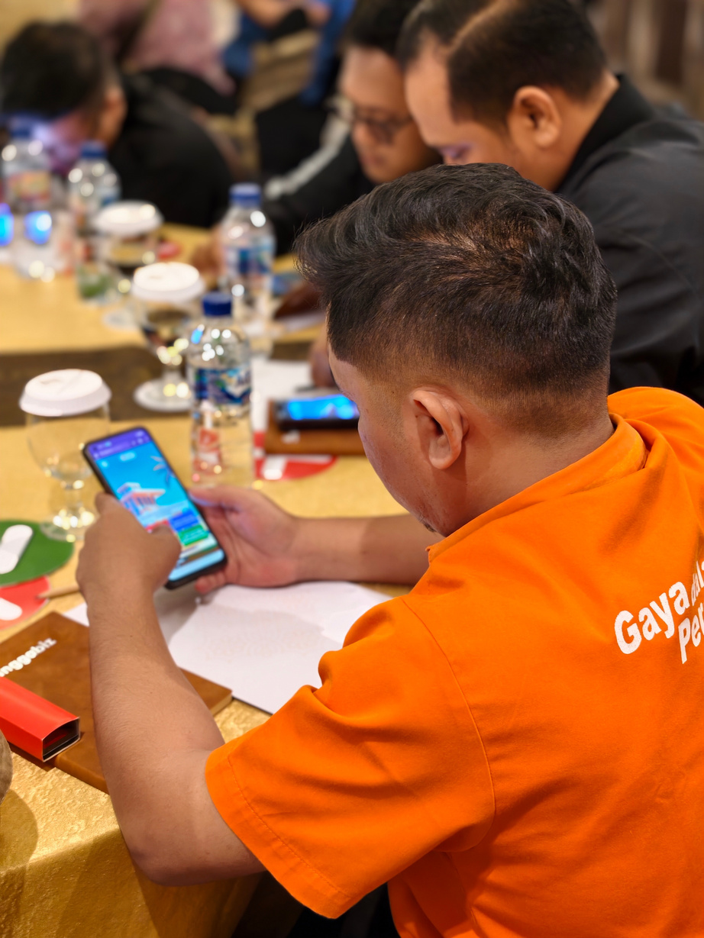
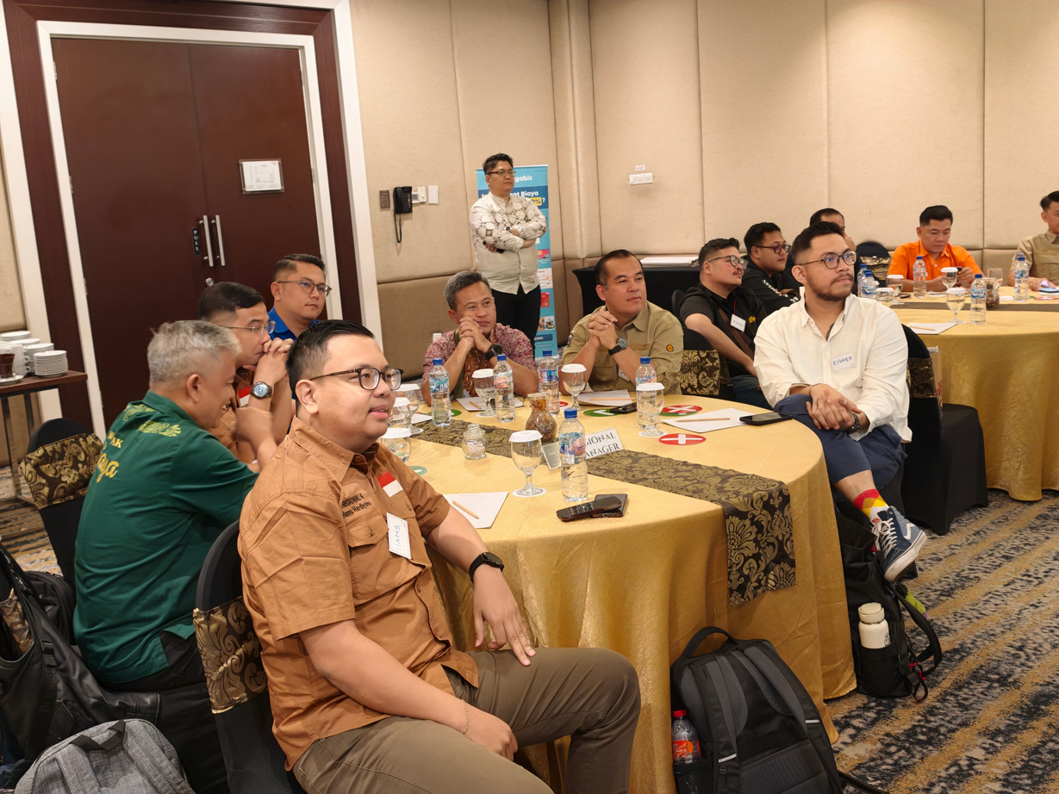
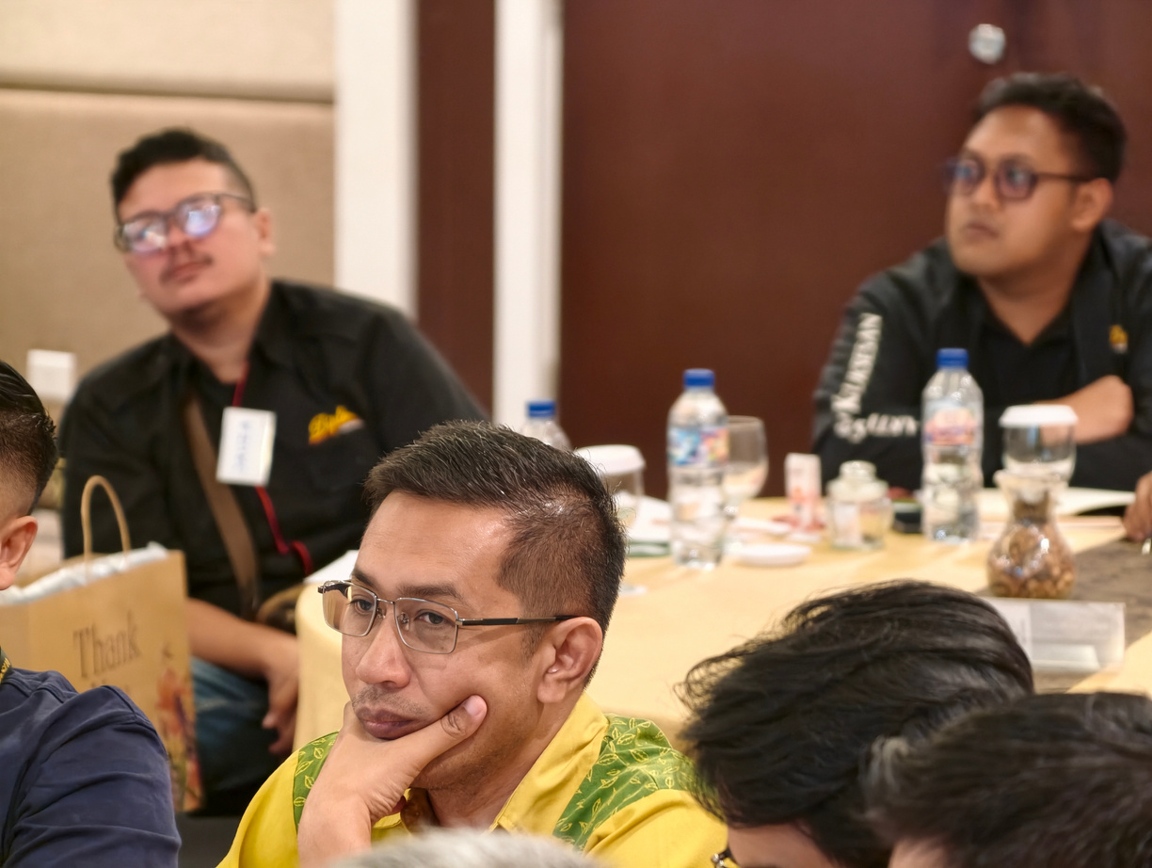


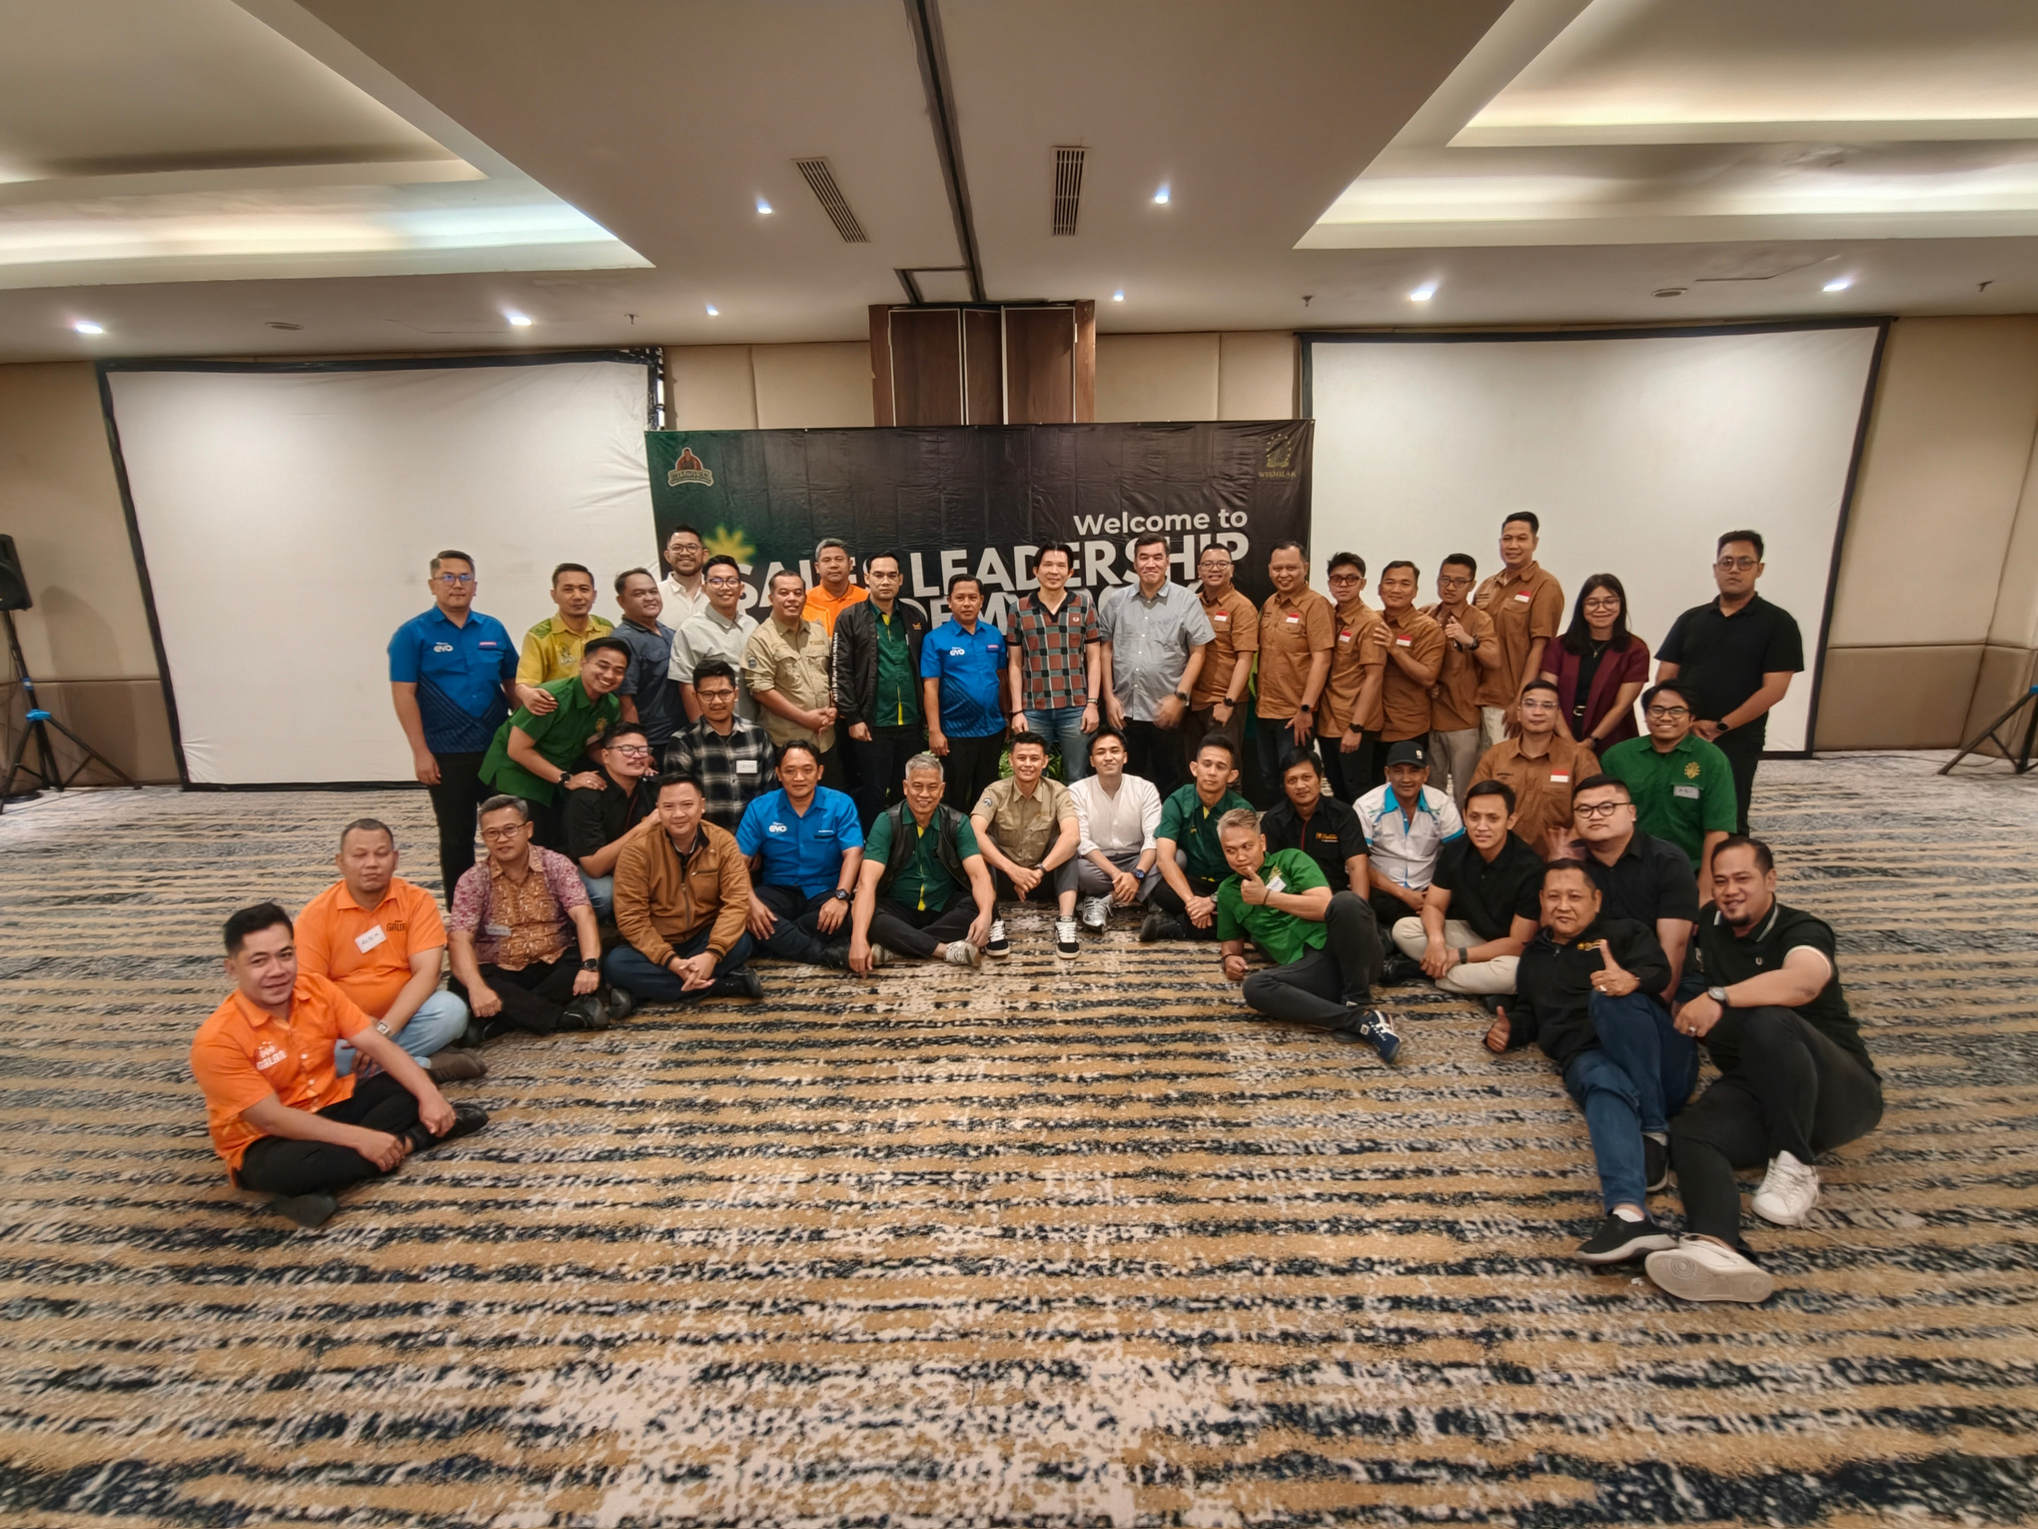


Our Training Portfolio
PT Gawih Jaya
LIST OF MATERIALS:
  Financial Acumen & P&L Awareness, Understanding P&L structure and driving responsible, profit-oriented growth aligned with bonus performance.
  Product Mix & Trade Investment Control, Managing profit vs. subsidized products, controlling promo cost ratios, and eliminating cross-brand profit erosion.
  Contextual Market Analytics, Transforming internal data (Scan, SFA, Nielsen) and market signals into data-driven commercial decisions.
  Gamified P&L Simulation, Executing commercial trade-offs (Pricing, Volume, Credit Terms) on a real-time simulator engine to balance growth and profit.
  Strategic Sales Action Plan, Translating market dynamics and P&L results into 1 Decisive Move and actionable quarterly sales plans.
August 2026
Area Sales Manager, Area Marketing Manager
40 Participants
Finance

Slide 16
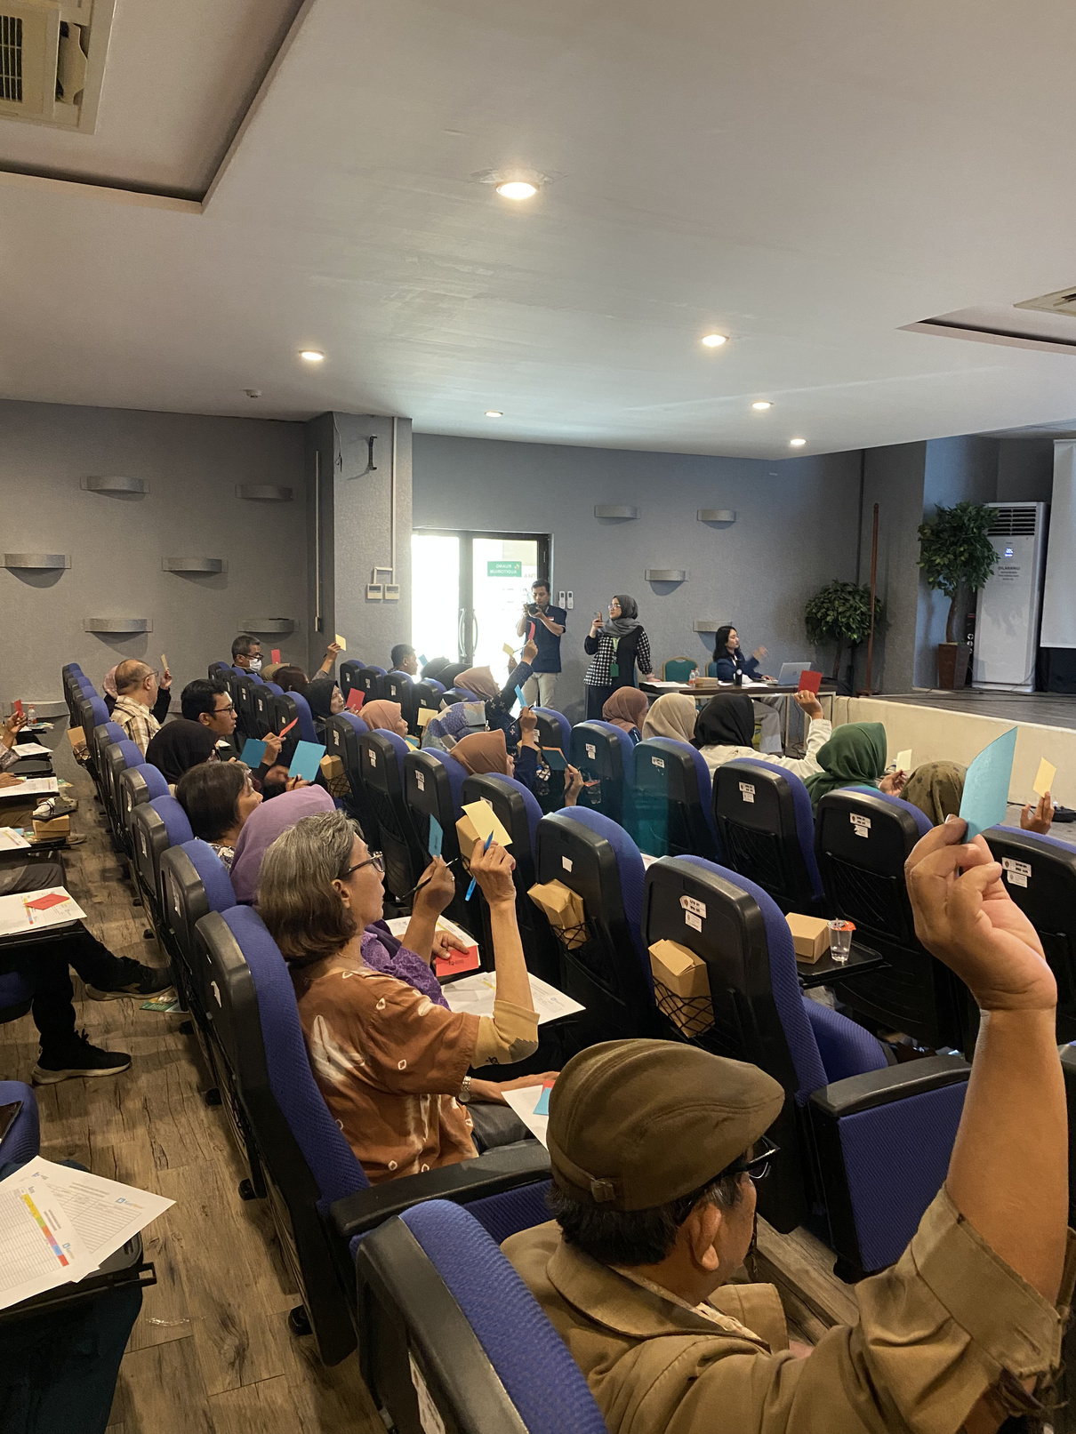
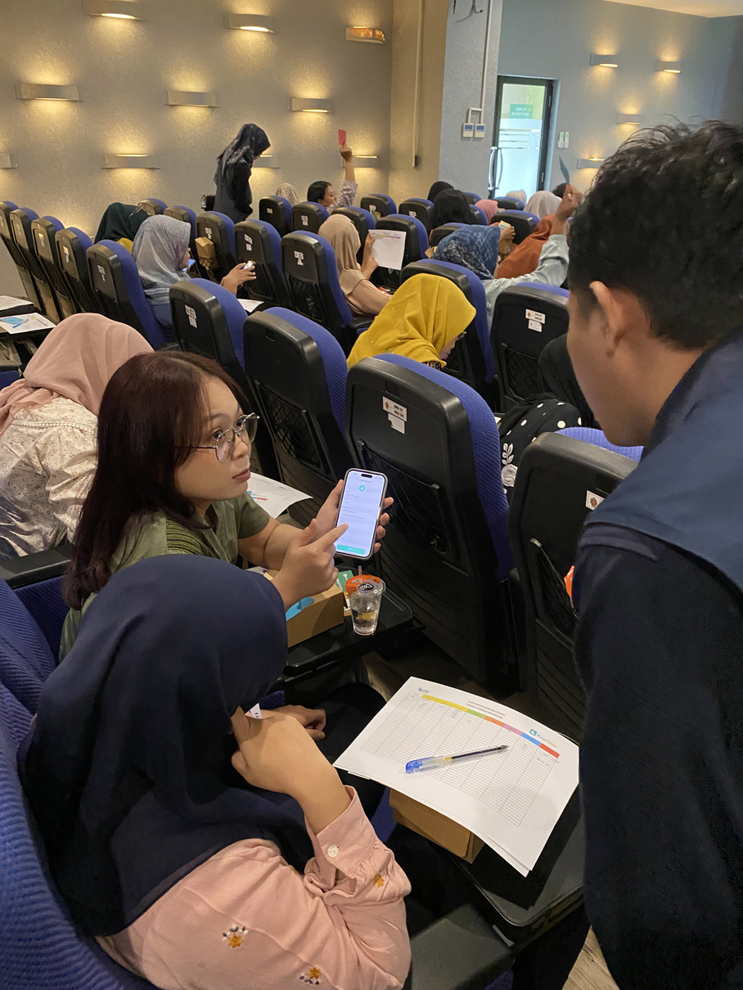
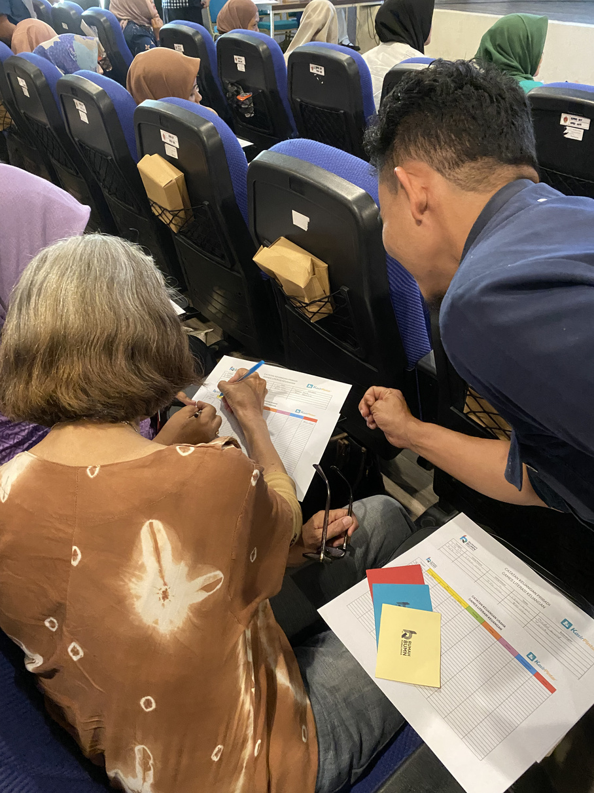

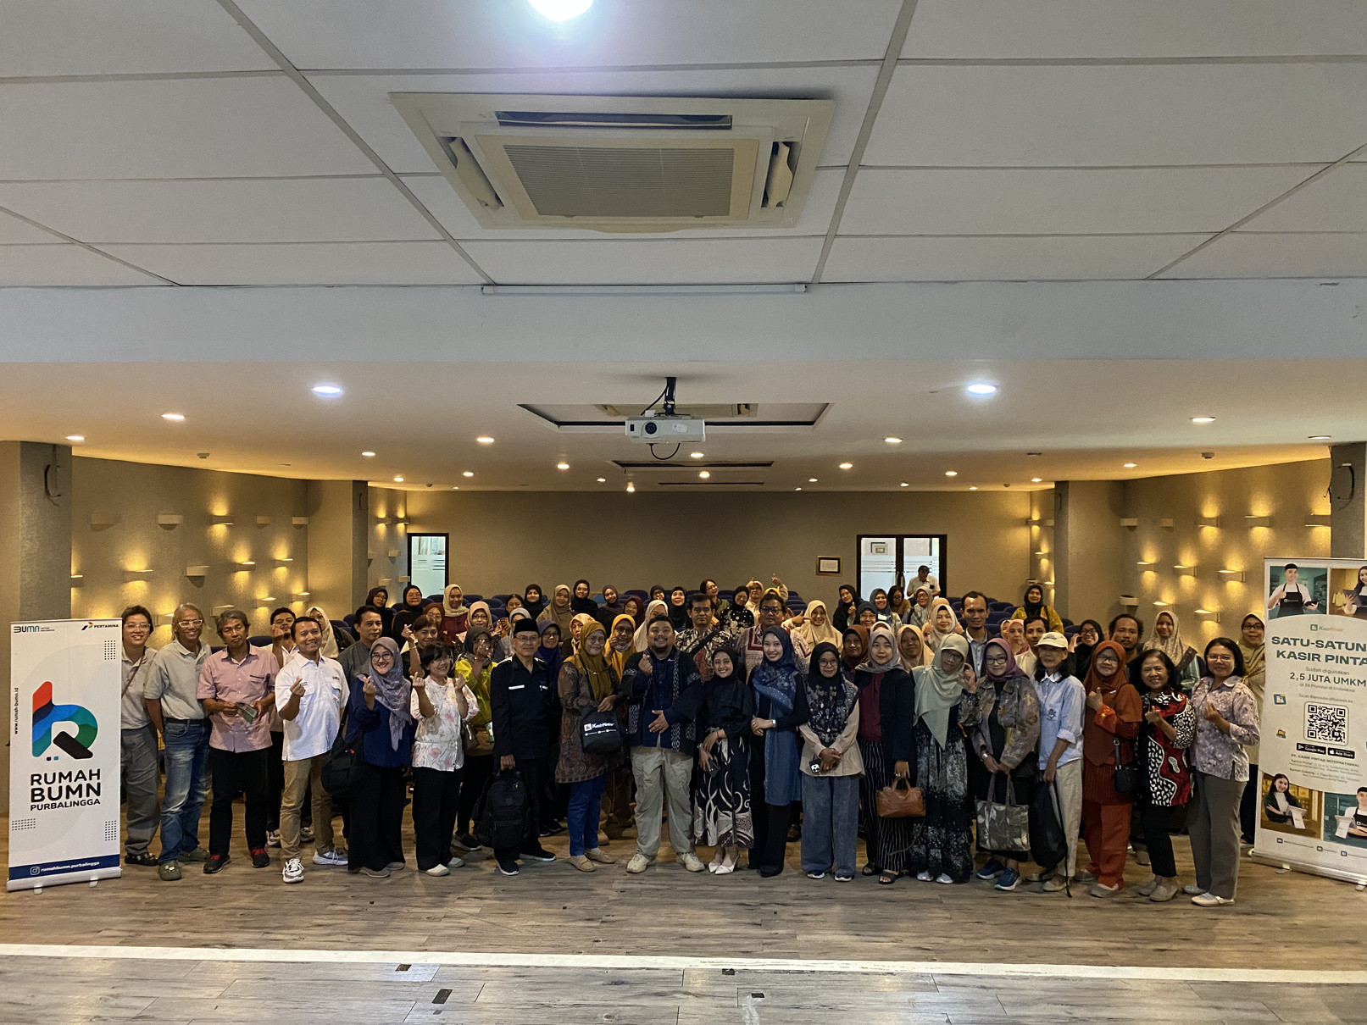
Our Training Portfolio
PT Kasir Pintar International
LIST OF MATERIALS:
  Fundamental Financial Literacy and Management, Understanding essential accounting principles and the importance of disciplined financial recording to prevent business bankruptcy.
  Digital Point of Sales Integration , Implementing digital cashier systems to automate sales transactions, stock management, and real-time financial reporting.
  Strategic Business Cash Flow Separation, Mastering techniques to separate personal and business finances for better capital control and sustainability.
April 2026
Individual from SME
110 Participants
Financial

Slide 17
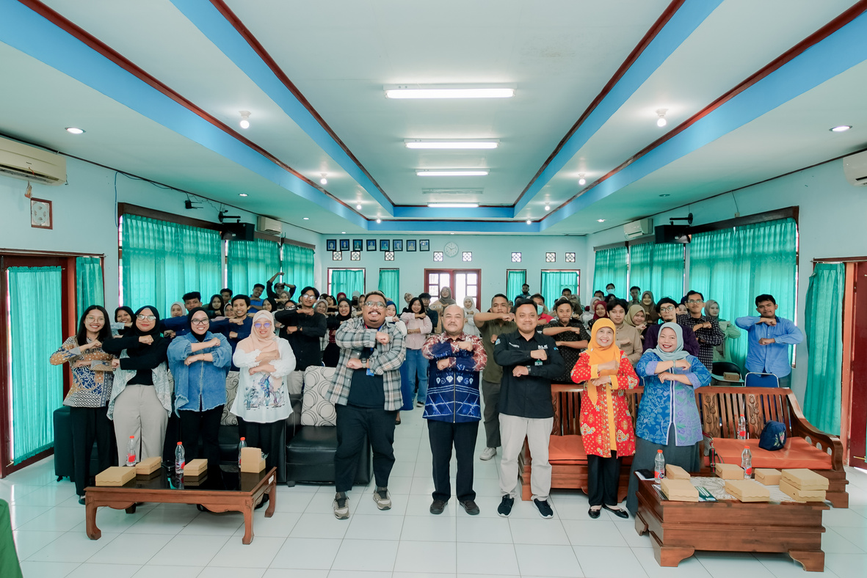
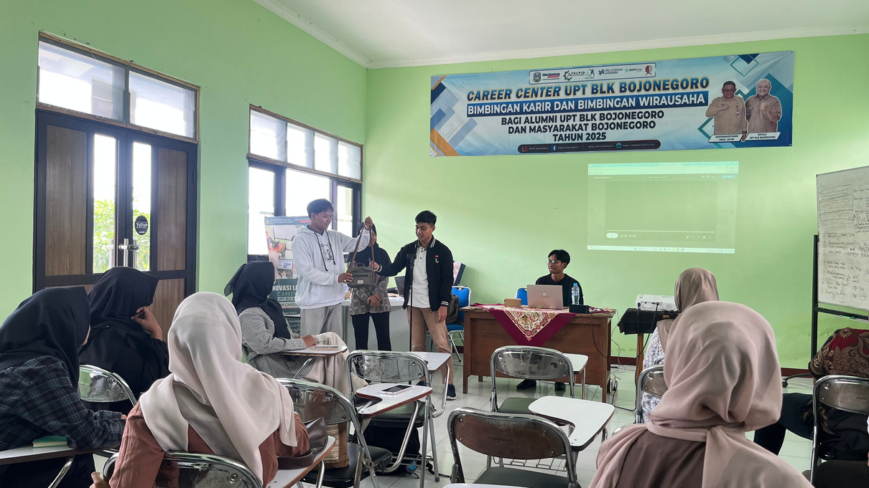
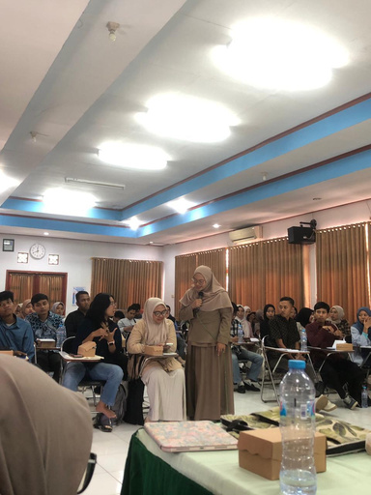
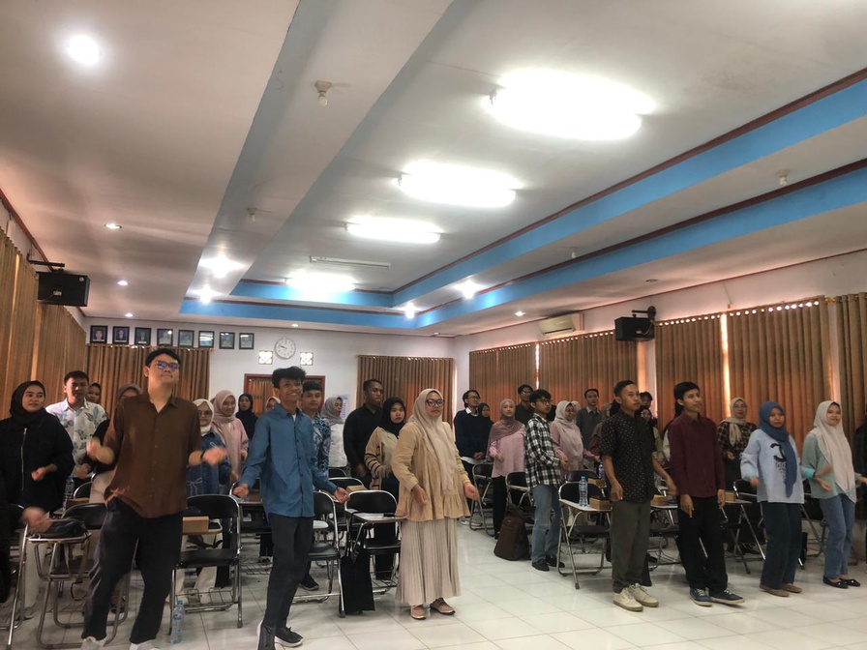
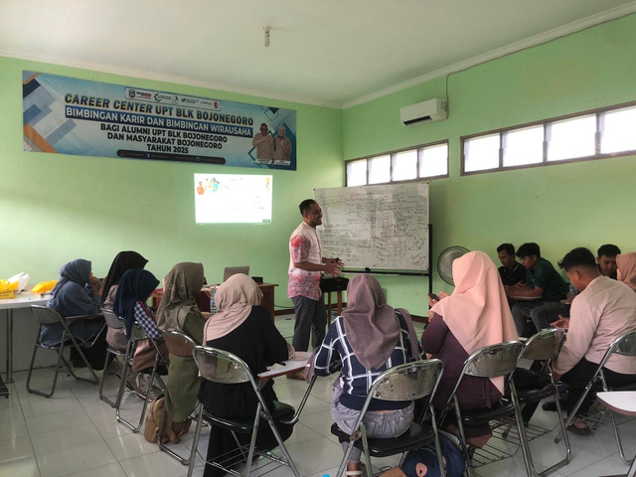
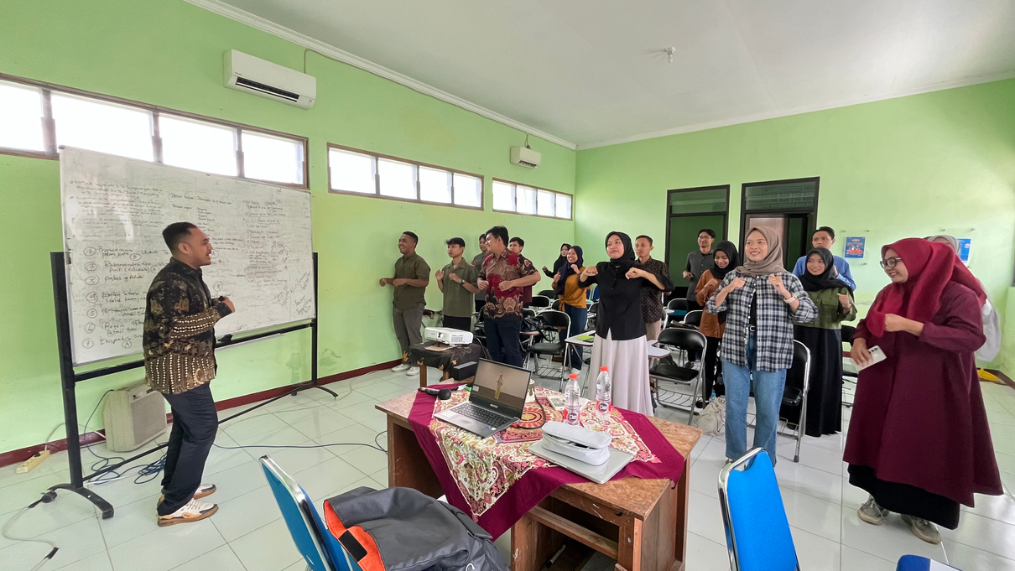
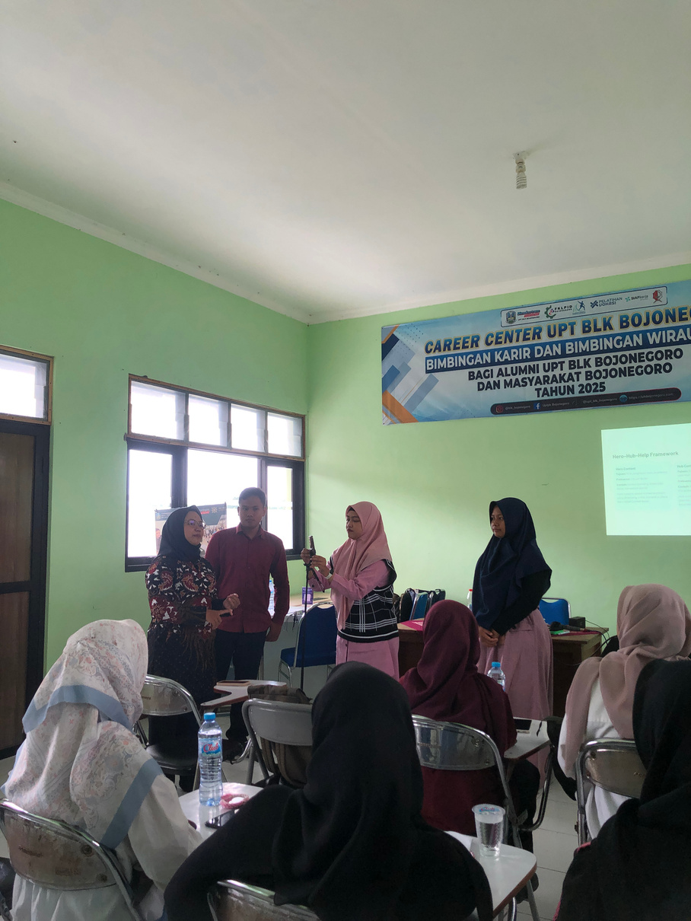
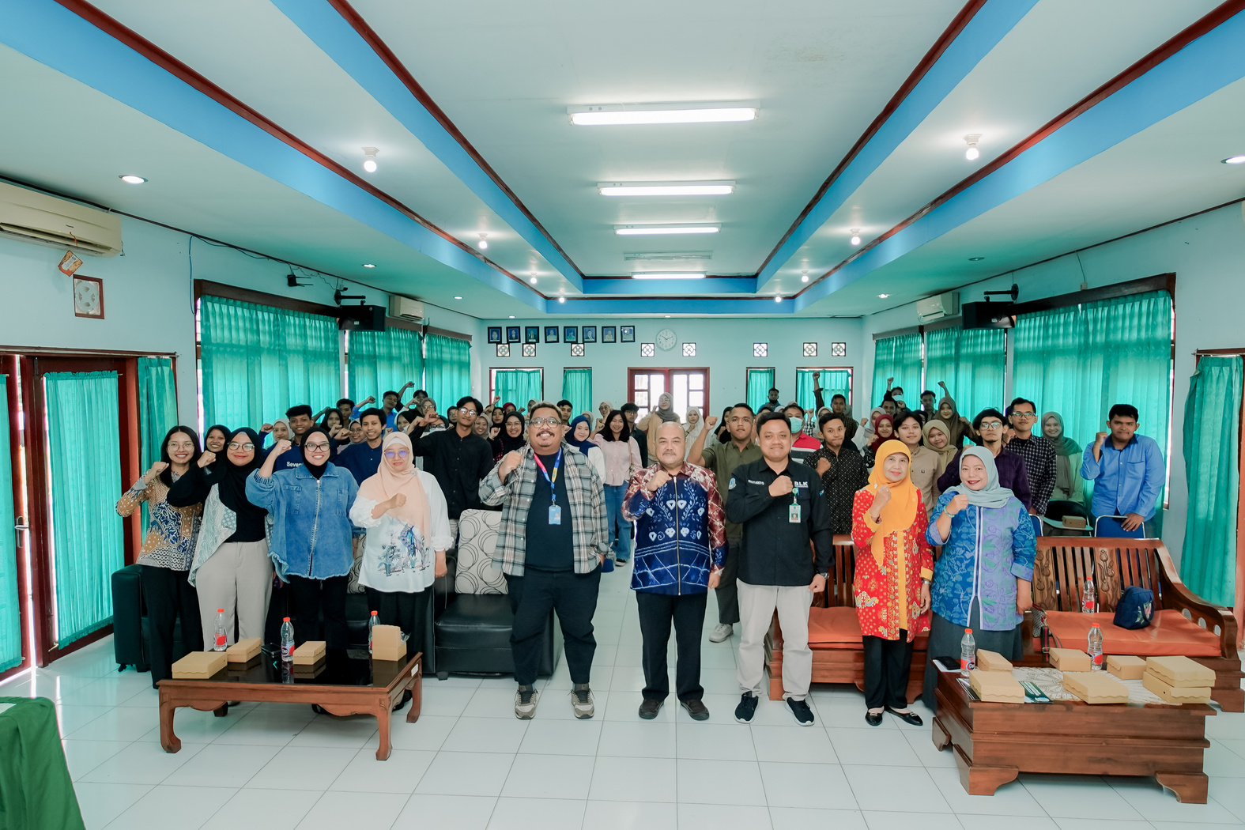
Our Training Portfolio
TechPath Bojonegoro
End to End Program Training
LIST OF MATERIALS:
  Strategic Digital Marketing & Performance, Mastering data-driven marketing strategies, SEO, and advertising to effectively scale business growth and visibility.
  Creative Content Production & Branding , Developing high-quality visual assets and storytelling techniques to build strong, engaging digital brand identities.
  Professional Career & Job Readiness, Equipping participants with essential soft skills, professional ethics, and tools for successful workforce integration.
December 2025 - Maret 2026
Individual
69 Participants
Digital Marketing
Content Creation
Soft Skills & Job Readiness

Slide 18
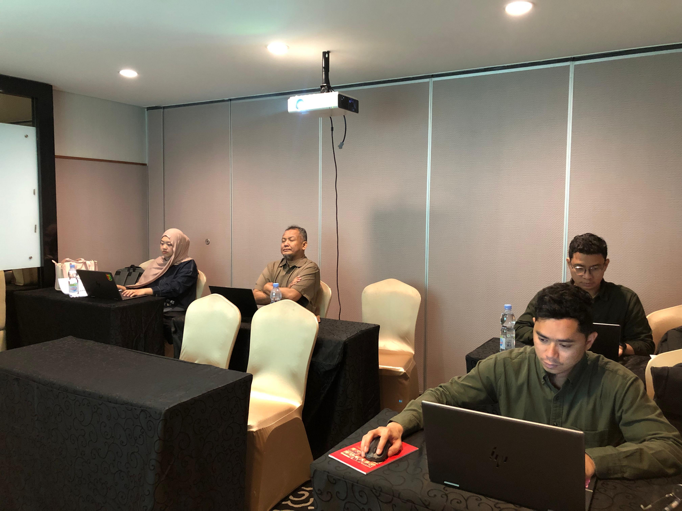
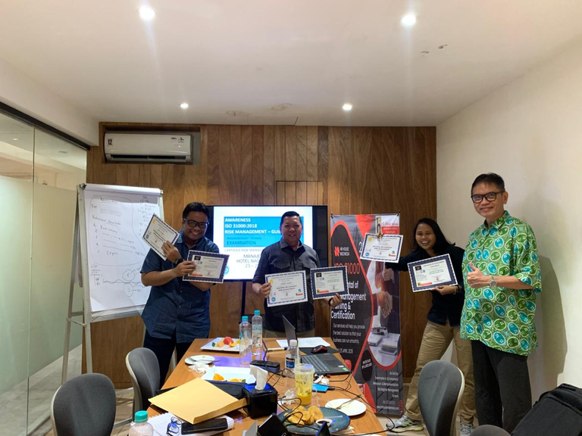

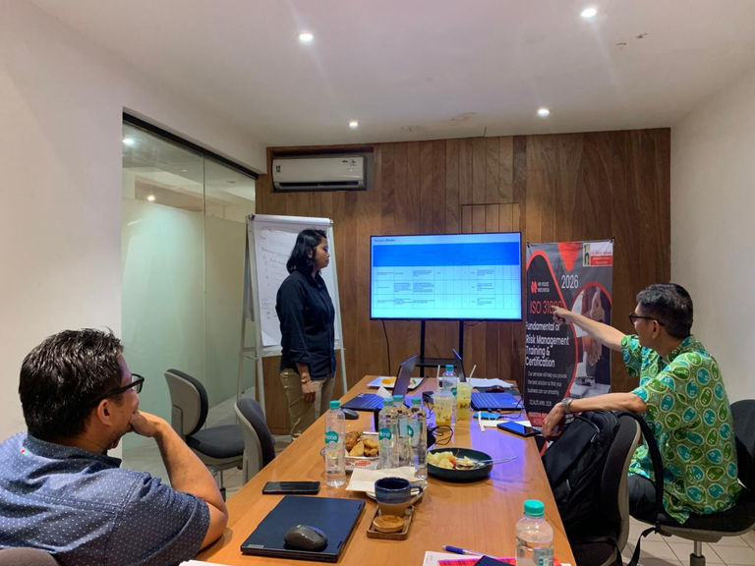
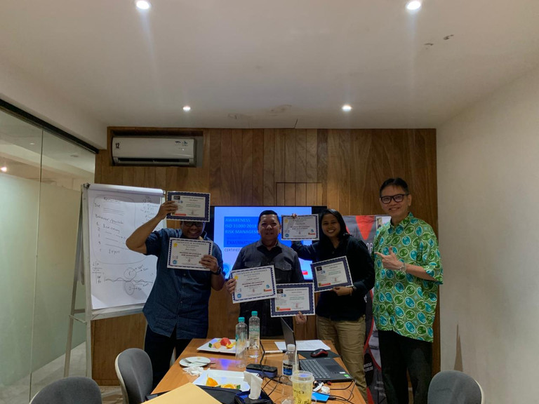
Our Training Portfolio
PT Riau Petroleum Rokan
LIST OF MATERIALS:
  BNSP Public Relation
  BNSP Legal Audit
  BNSP Asset Management
  BNSP Internal Auditor
  ISO Risk Management
  ISO 14001 & 26000
  ISO 30414
  ISO 19011
April 2026
Corporate
19 Participants
BNSP Training & Certification and ISO Training

Slide 19
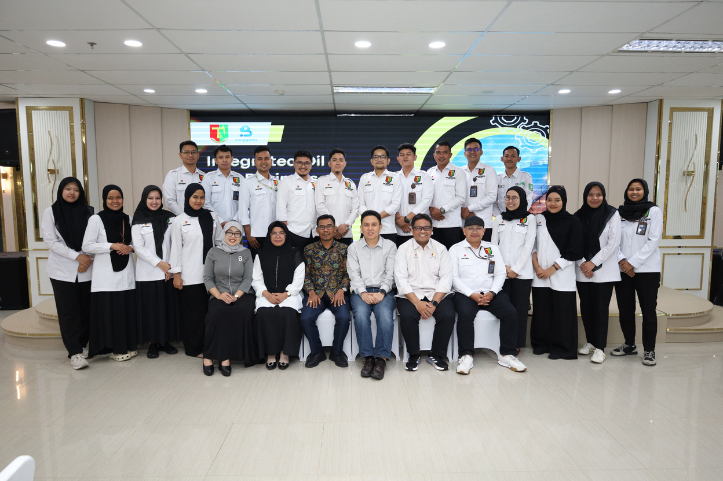
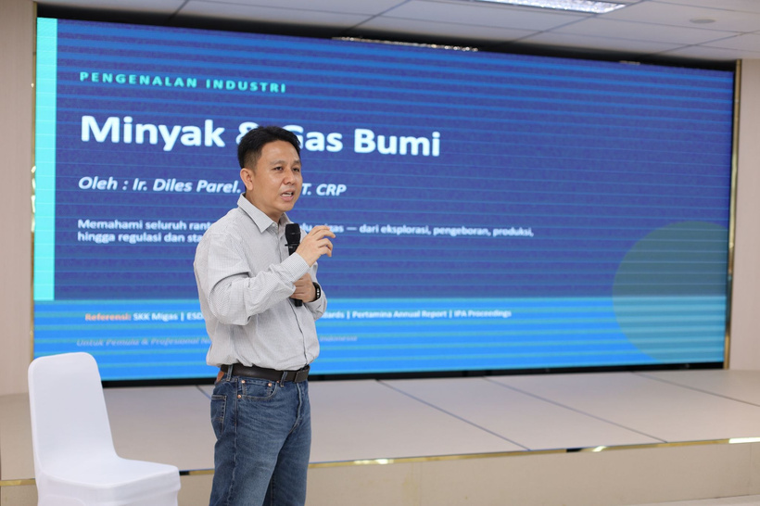
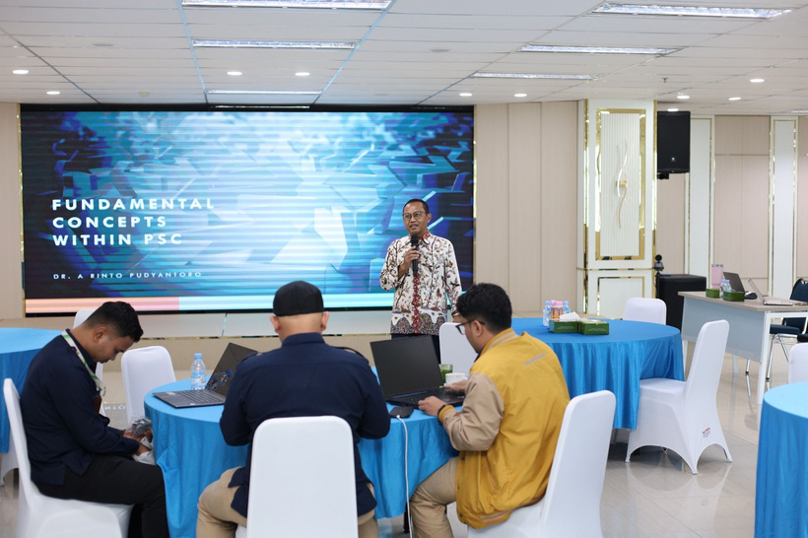
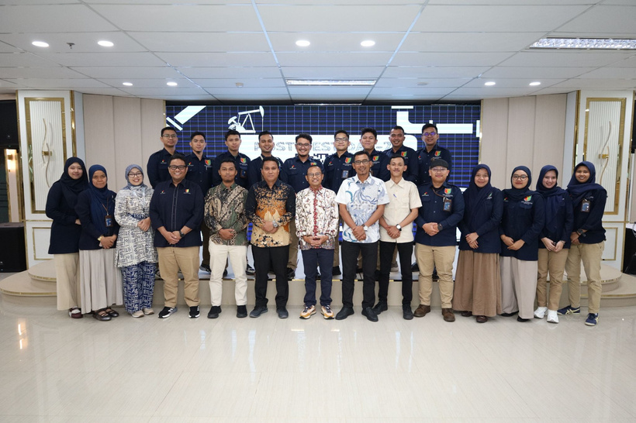
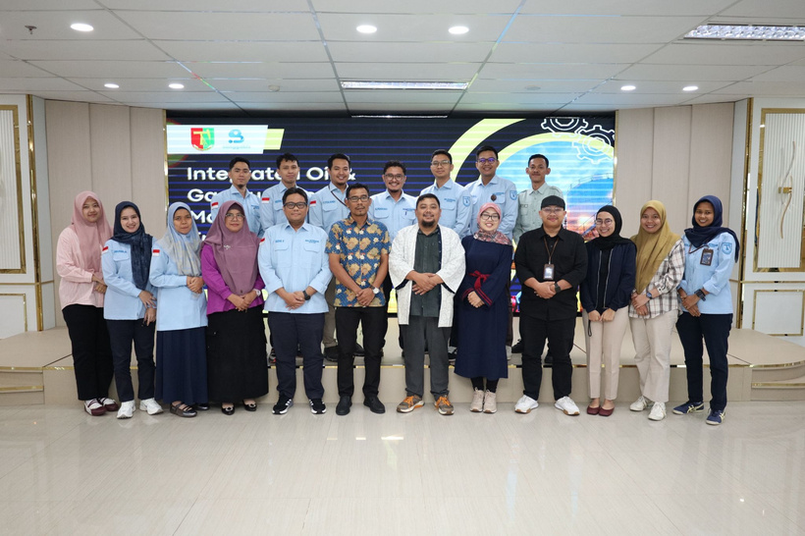
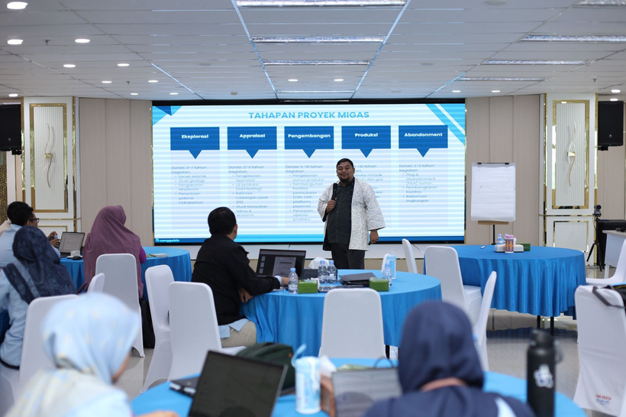
Our Training Portfolio
PT Riau Petroleum Rokan
April 2026
LIST OF MATERIALS:
  Modul 1: Oil & Gas Industry Fundamentals and Regulatory Overview
  Modul 2: Upstream Operations & Production Management
  Modul 3: Tax Management and Fiscal Compliance in Oil & Gas Operations
Corporate
30 Participants
Integrated Oil & Gas Business Management Training

Slide 20
Our Training Portfolio
PT Riau Petroleum Rokan
November 2025
LIST OF MATERIALS:
  Module 1: Overview of the Oil & Gas Industry and Business Cycle
  Module 2: Oil & Gas Project Cost Structure and Cost Recovery
  Module 3: Accounting and Financial Reporting
  Module 4: Strategic Financial Planning
  Module 5: Efficiency and Compliance Strategies
Corporate
8 Participants
Oil & Gas Industry Fundamentals and Fiscal Compliance

Slide 21
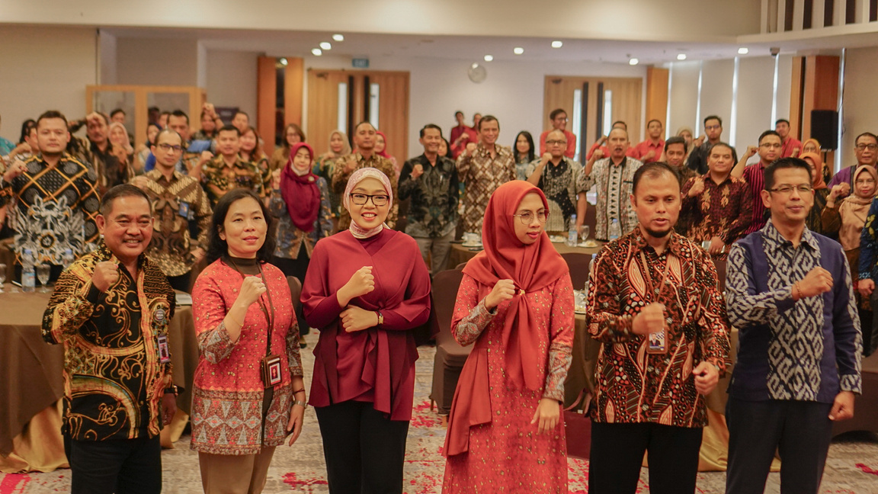
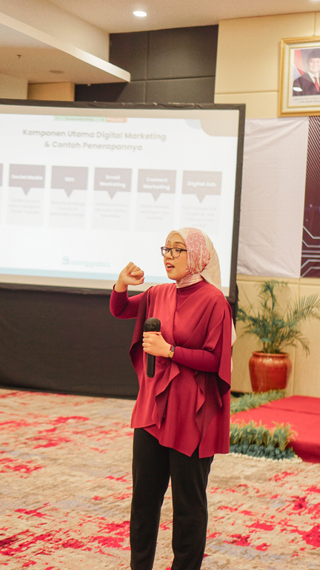
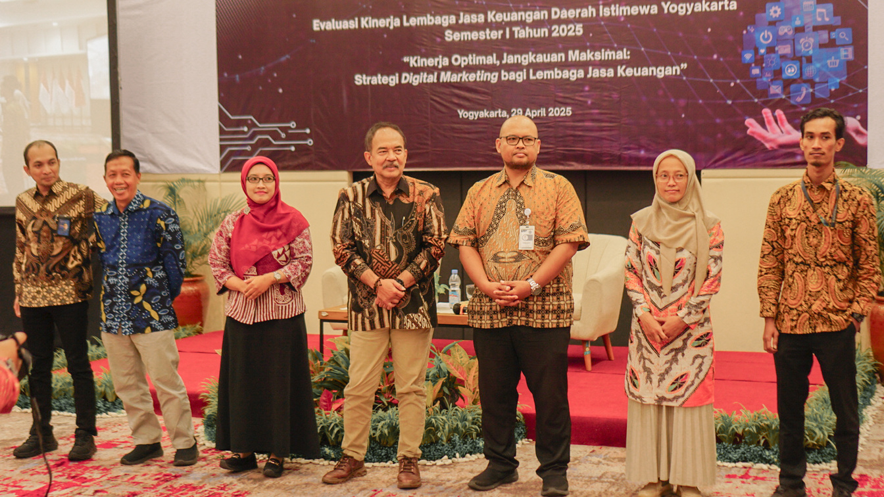
Our Training Portfolio
Online Webinar Training
LIST OF MATERIALS:
  Managing Task
Using the framework of Project Charter, Eisenhower Matrix, and Gantt Chart.
  Managing People - Team Member
The importance of increasing the relationship with the team members so that they are able to open up and having psychological safety, along with how we could disagree by design.
  Managing people - Other Stakeholder
How as a Leader, we need to be able to influence the horizontal lines, other Leaders, and also balancing the roles with managing upper management's expectations.
June 2025
Individual/Corporate
20 Participants
Leadership for First Time Leaders and Managers

Slide 22

Our Training Portfolio
Otoritas Jasa Keuangan (OJK) Yogyakarta
LIST OF MATERIALS:
  Understanding the Landscape of Digital Marketing in the Banking Industry
  The Importance of Digital Marketing for the Banking Sector
  Key Components of Digital Marketing and Their Application in the Banking Industry
  Growing Through the “DIGITAL” Approach
  Simulation: Defining Target Market, Product Offerings, and Digital Communication Strategies
  Interactive Case Study: Selecting Advertisements in Compliance with OJK Regulations
  Compliant Content Checklist
April 2025
Corporate
50 Participants
Tumbuh di Era Digital:
Strategi Marketing Lembaga Keuangan yang Patuh Regulasi OJK

Slide 23
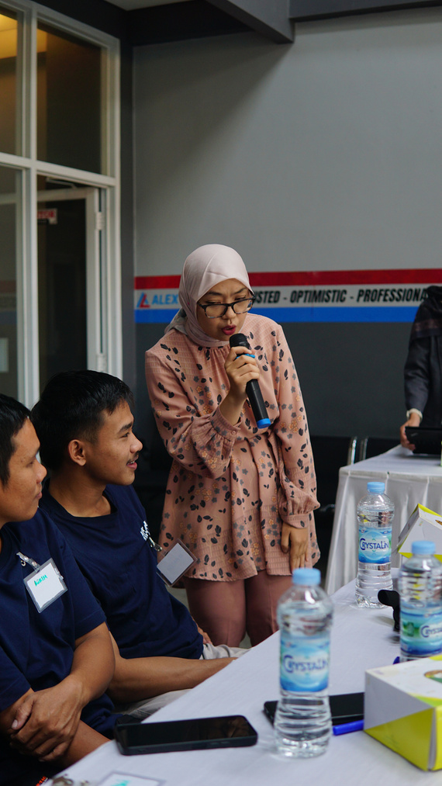






Our Training Portfolio
Alex AC Mobil Semarang
LIST OF MATERIALS:
  Leadership Mindfulness
  Lead Yourself
- Problem Solving & Critical Thinking
- Time Management & Productivity
3. Lead Others (and the Society)
- Teamwork & Collaboration
- Ownership Mindset
- Customer Service Excellence (Hospitality)
4. Grow Another Leader
Mei 2025
Corporate
25 Participants
Naik Level di Tempat Kerja:
Ownership, Customer Excellence & Productivity

Slide 24

Our Training Portfolio
Indosat Ooredoo Hutchison
LIST OF MATERIALS:
  Understanding Gen Z
  Main Metrics in Socmed Measurement
  Crafting Effective Responses
  Engaging Content for CS
  Dealing with Difficult Situations
  Interactive Session and Role-Play
July 2024
Corporate
30 Participants
Effective CS Techniques for Gen Z on Indosat Ooredoo’s Socmed

Slide 25

Our Training Portfolio
PT Vertika Technologies Nusantara (Rey.ID)
LIST OF MATERIALS:
  Classifying Customers and Spot The Main Problem
  Building the Through Solutions for The Main Problems
  Communicating the Solutions in an Attentive Way
  Learning the Difference in Communication
  Implementing the Knowledge in Real-Case Experience
  Retrospective Team Meeting
November 2022
Corporate
+/- 20 Participants
Managing Hard Complaints:
Turning Your Angry Customers into Your Loyal Ones

Slide 26


Our Training Portfolio
Program Pra Kerja
LIST OF MATERIALS:
Customer Services
  What is Customer Service?
  Customer Service Values
  Customer Loyalty Building Methods
  Customer Channel Type
  Type of Ticket & Basic Ticketing Workflow and Escalations
  Type of CRM System, etc
SME Accounting
  Introduction to Accounting and Finance Functions for Startups and SMEs
  Application of Accounting Concepts and Cycles in Business
  Recording and Bookkeeping of Transactions
  Accounting Reports and Simple Analysis
  Cash Flow Management
  Technical Tax Calculation and Reporting, etc
Entrepreneurship
  Sustainable Agriculture with Permaculture Method
  Crafting Healthy Menus with Local Crop Diversity
  Organic and Healthy Menu Management for Restaurants, etc
July - November 2023
July - November 2024
Public Training
+/- 4000 Participants
  Customer Service
  SME Accounting
  Entrepreneurship

Slide 27




Our Other Training Portfolio
December 2022
November 2023
April - May 2023
September 2022
Corporate
Public Training
Corporate
15 Participants
400 Participants
9 Participants
Zendesk Optimization Tools for Happiness Agent’s Leader
Accounting and Financial Management for Foundation
Digital Finance:
POS Financial App

Slide 28

Class Management Portfolio
LingoTalk
July 2023 - Present
28+ Gov Institution and Non Gov Institution
350+ Business English
Class
1000+ participants
Sanggabiz offers a comprehensive Class Management Service designed to assist clients in managing all operational aspects of their classes efficiently. Our service ensures timely and effective class administration, encompassing key activities such as Class Enrollment, Class Reminders, Class Administration, and Post-Class Document Uploads.
With this service, clients can focus entirely on developing content and delivering quality instruction, while we handle all supporting administrative requirements to ensure the smooth operation of their classes.

Slide 29





TRAINING
SISTEM KEUANGAN - 2022

Slide 30




TRAINING
SISTEM KEUANGAN - 2023

Slide 31

TRAINING
COMMUNICATION SKILLS

Slide 32



TRAINING
HARD COMPLAINTS

Slide 33


TRAINING
DIGITAL MARKETING

Slide 34



TRAINING
DIGITAL
LITERACY PEREMPUAN

Slide 35

TRAINING
CS & AKUNTANSI
(PERIODE 2023-2024)

Slide 36








ENVIRONMENTAL SEMINAR

Slide 37





MSME TRAINING RUMAH BUMN
Surabaya, Purbalingga, Labuan Bajo, Yogyakarta, Jakarta, Bojonegoro, Kabanjahe, Samarinda, Pekalongan, dst.

Slide 38




Success Story
Kitabisa.com
Mosaic Wellness
Kasir Pintar
AQM
Exceliga
Sanggabiz saat ini sudah jadi salah satu solusi bisnis yang komprehensif, tidak hanya alih daya tapi lebih dari itu Sanggabiz bisa memberikan fleksibilitas yang berarti untuk bisnis - Hermawan (Manager Ops)
Sanggabiz’s service was exceptional!
They CONSISTENTLY EXCEEDED MY EXPECTATION. Their sense of ownership towards my product went beyond completing the assigned task; they also provided valueble insights for improvement, drawing form their personal experiences. I look forward to reaching out to them again for any future project. - Rency (Project Mgr)
Nyenengin banget ya kerjasama bareng Sanggabiz. Yang paling utama sih gercep. Fast response banget. Dan pastinya helpful. Jadi kalau misalnya ada yang kurang - kurang, kita butuh bantuan apa, dari tim Sanggabiz-nya sangat helpful sekali - Anissa (Partnership)
Kami belum memiliki pengalaman yang cukup di Customer Servicing. Namun dengan adanya Sanggabiz saya jadi punya sparing partner untuk memperbaiki proses dan sistem customer service. Improvement yang paling berasa punya standard yang clear untuk setiap proses dan insight baru untu di-improve. - Owner
Tentang Sanggabiz, teamnya profesional dan proper untuk deliverynya, untuk report profesional, untuk data controlnya profesional, bisa rekomendasikan ke kolega untuk pakai Sanggabiz sebagai jasa profesional. - Owner
Elevate Your Business As Our Clients
and other
75+ Clients

Slide 39




Let’s Get on the Road with
www.sanggabiz.com
@sanggabiz
partnership@sanggabiz.com
Yogyakarta | Jl. Bambu Gading No.111, Sendon, Tirtoadi, Kec. Mlati, Kabupaten Sleman, Daerah Istimewa Yogyakarta 55287

